Slide 1
Software Development Project-II
Course Code:CSE 3100

Slide 2

BANGLADESH ARMY UNIVERSITY OF SCIENCE AND TECHNOLOGY(BAUST)
Presented By:
MD. Saklain Sarowor (ID: 200101088)
S.M.A. Sayem Prodhan (ID: 200101091)
Md. Rayhan Ali (ID: 200101099)
MEHEDI HASAN JIM (ID: 200101078)
Dept. of CSE
Level:03;Term:01

Slide 3
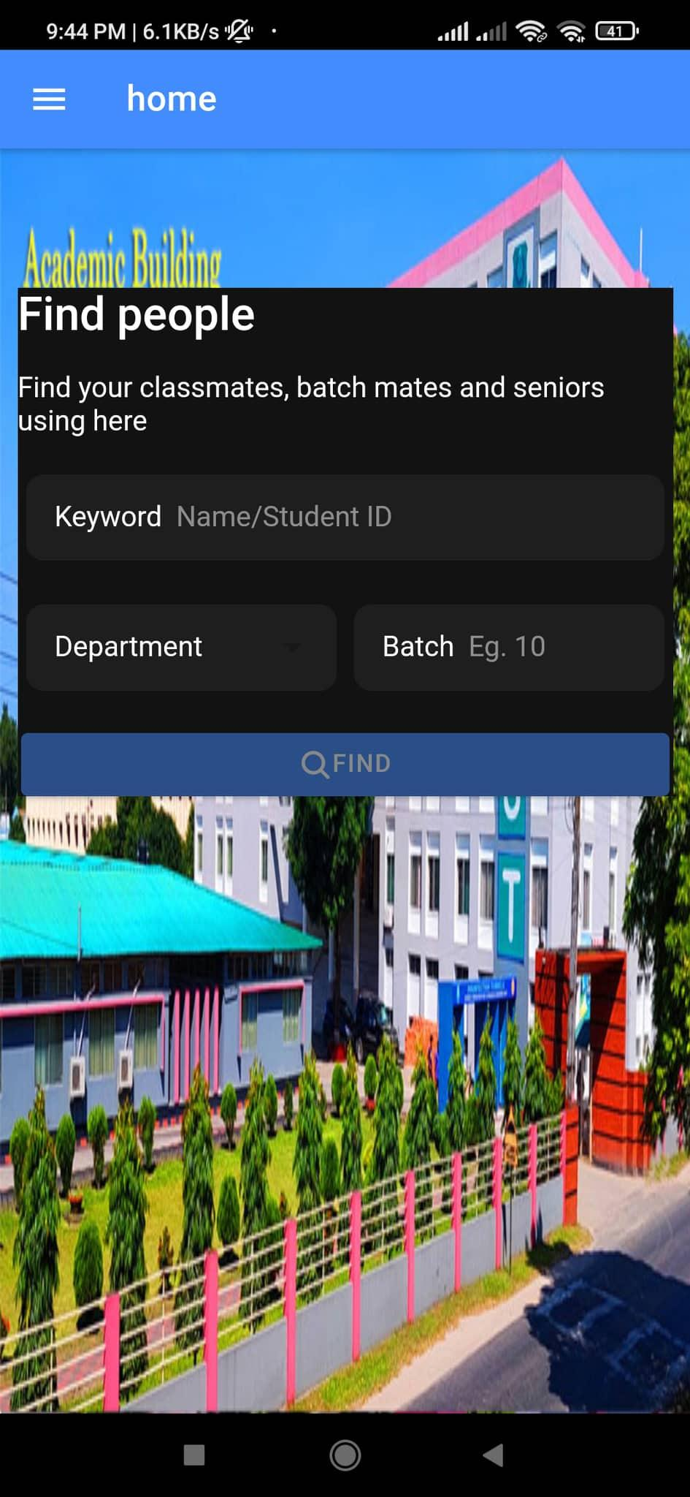
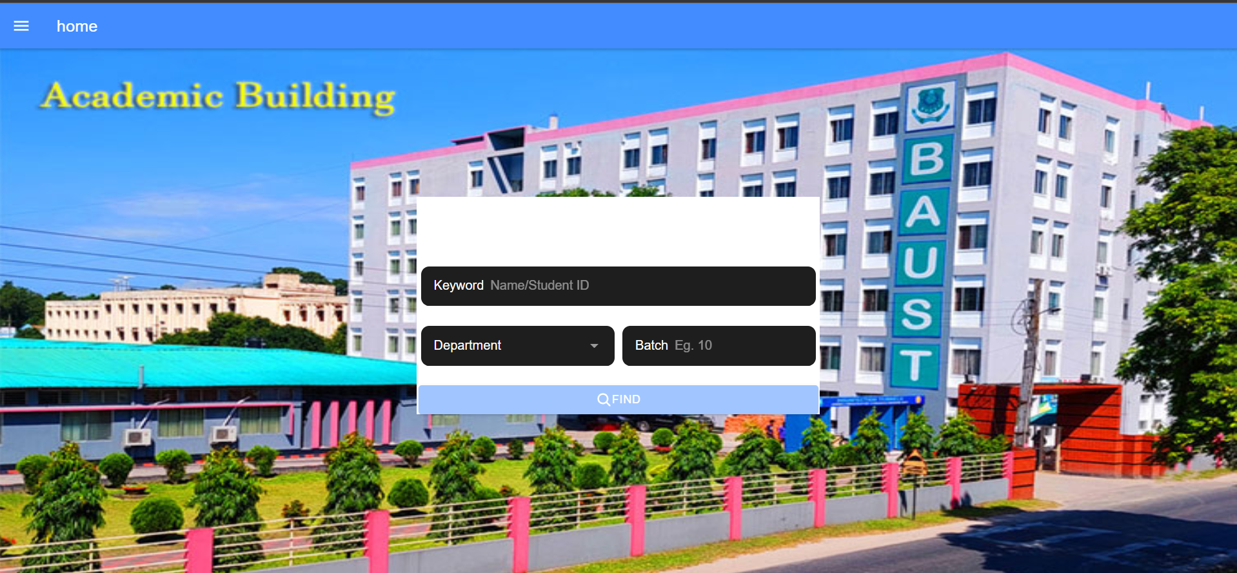
BAUSTian
A platform for BAUSTians to connect with each other
http://baustian.herokuapp.com/homepage

Slide 4
Introduction:
BAUSTian is a platform that will connect students of BAUST with their peers and seniors. It can establish a relation between students. In our system student can share about academic information and also share about the job field from ex-BAUSTians. Also fresher get help from seniors for higher study and job sectors.

Slide 5
Objective
To create a platform for BAUSTians to connect with each other
Connect with ex-BAUSTians for information about higher education in our country (Bangladesh) or abroad
Other career prospects.

Slide 6
Background studies
We did some study in other university student alliance for taking the idea about our project and make a easy app for student(BAUSTians).
We don’t use existing social media apps because they are too distractive.
So,we need a platform where only our university students can interact with each other without external distraction

Slide 7
Methodology and tech. stack
To build this project we need to build three distinct parts. We use the appropriate programming languages for each corresponding part
1. Backend
1.1. PHP (Laravel)
1.2. Mariadb
1.3. Nginx
2. Web User Interface
2.1. Ionic framework
2.2. Angular
3. Admin Panel
3.1. Ionic framework
4. Mobile App
4.1. Ionic framework
OS: Android and Linux(Backend)

Slide 8
Work distribution
S.M.A Sayem Prodhan
Database normalisation
Backend API development
Android APP
Frontend UI
Md. Saklain Sarowor
Database
Frontend UI
Android APP
Mehedi Hassan Jim
Frontend UI
Backend API development
Android APP
Md. Rayhan Ali
Android APP
Frontend UI
Backend API development
Everyone worked on modules which touch on all aspects (Frontend and Backend)

Slide 9
Advantages
Information sharing among peers and seniors.
Strengthening BAUST students in the real world job sectors.
Students get knowledge about their department and how to gain good cgpa.
Get easy life….

Slide 10
Disadvantages
In this project is that no one else but baustian can use this application
This can result in the failure of the hole project

Slide 11
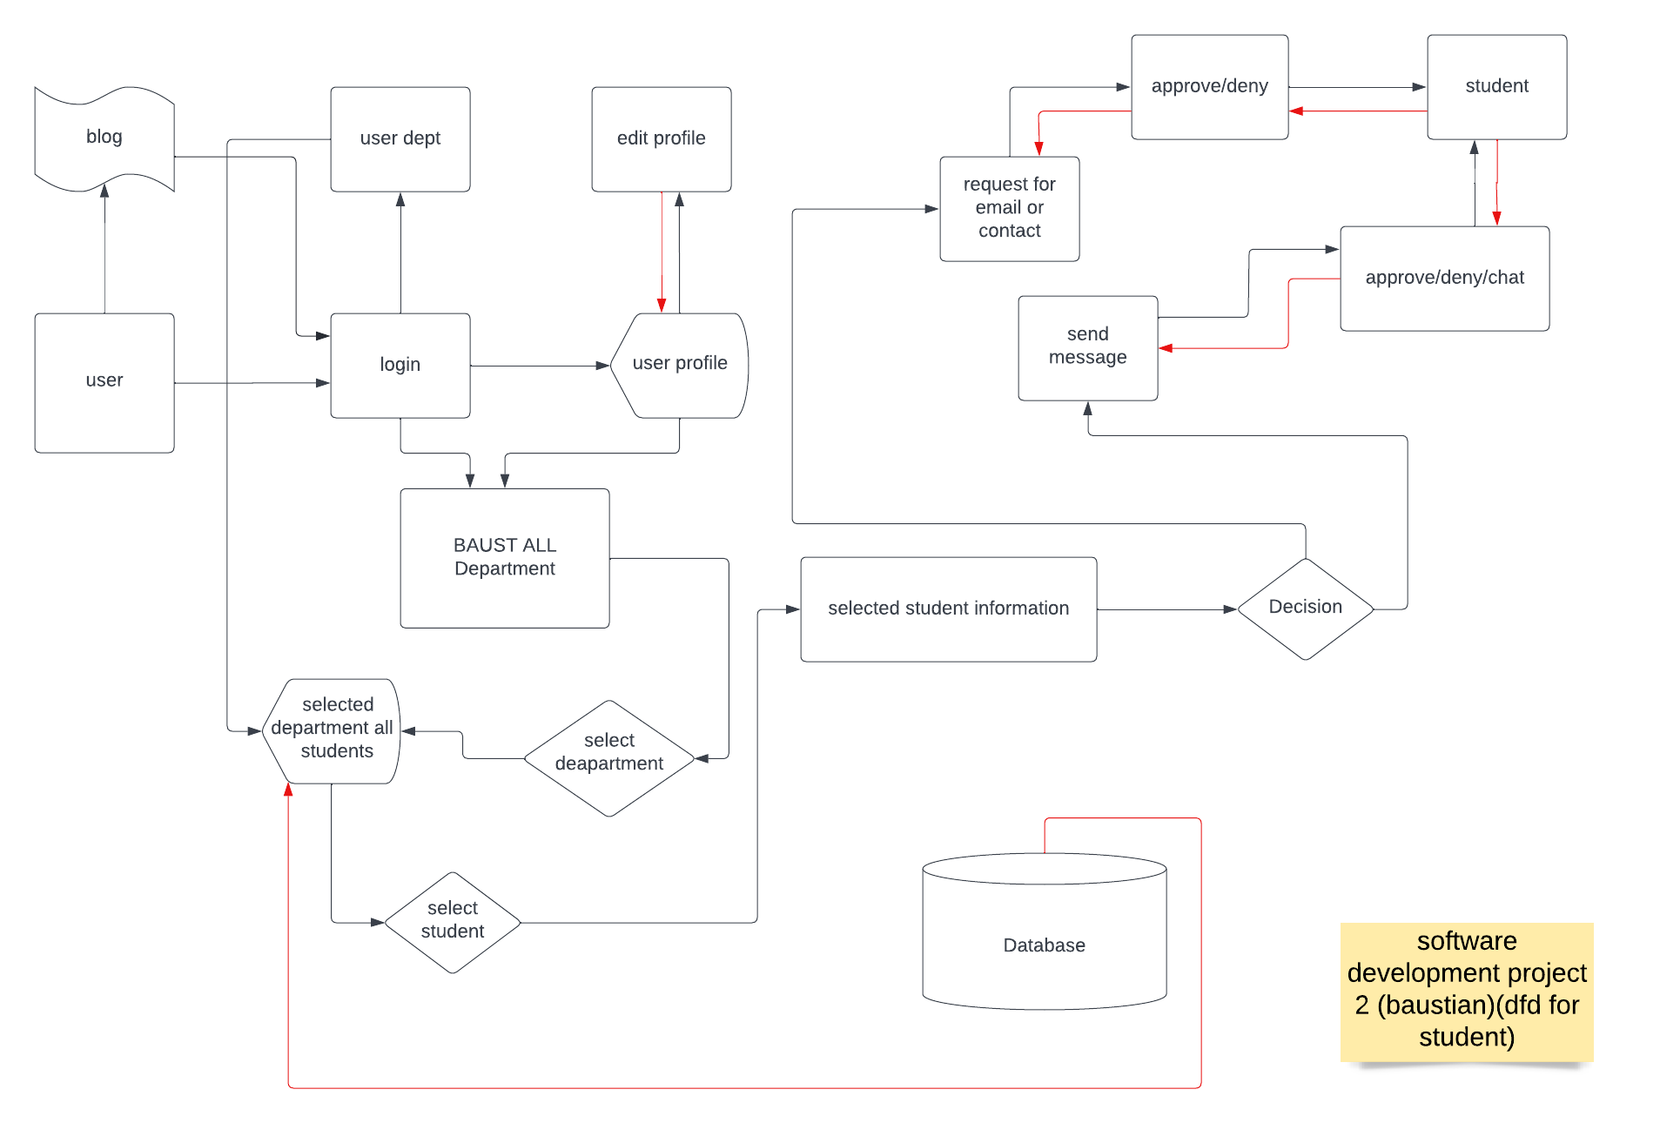
Data Flow Diagram for Student:

Slide 12
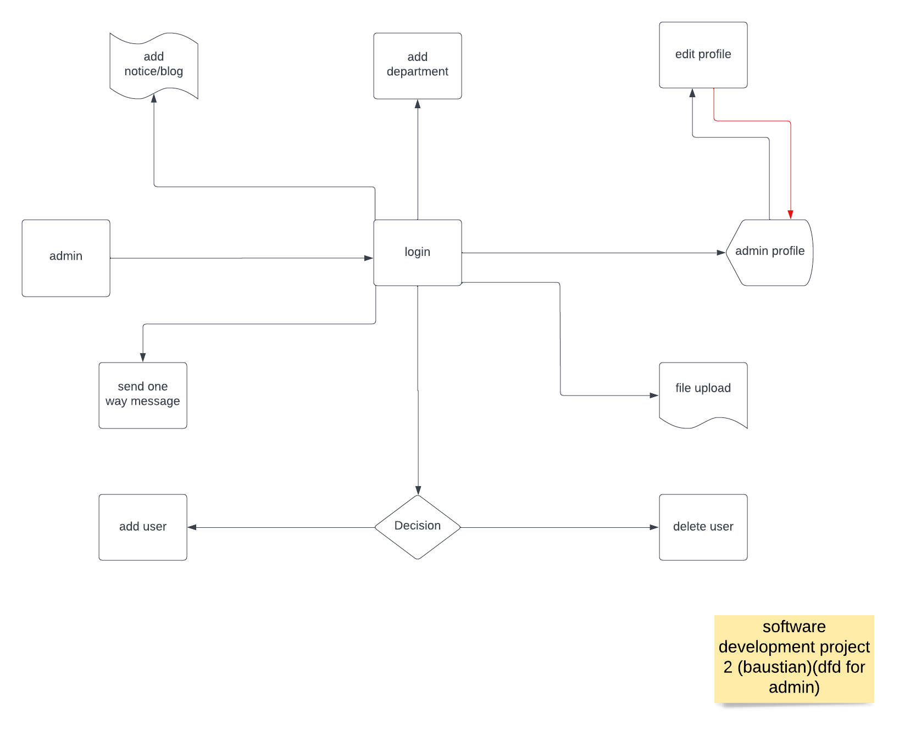
Data Flow Diagram for Admin:

Slide 13
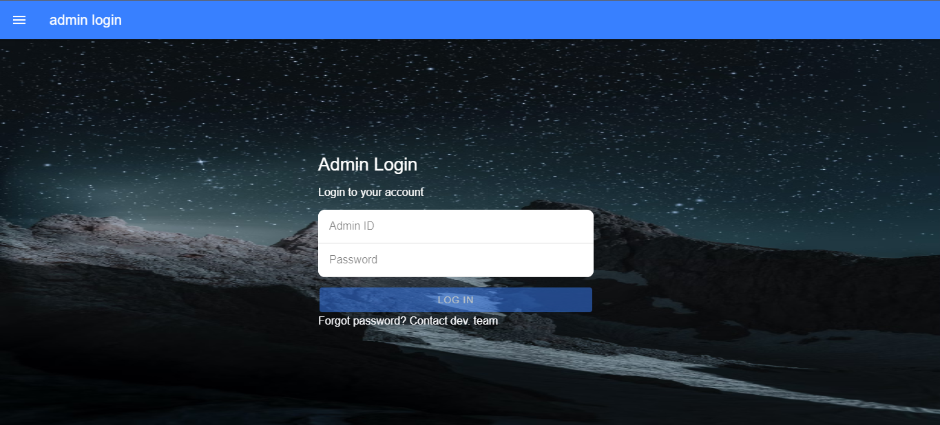
Admin Panel
Admin Login:
Database

Slide 14
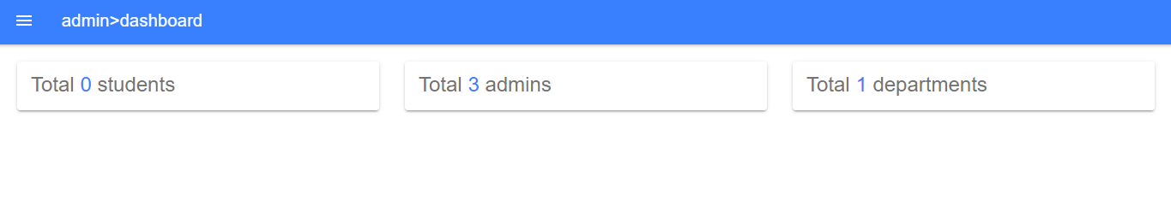
Admin Panel
Admin Dashboard:
Database

Slide 15
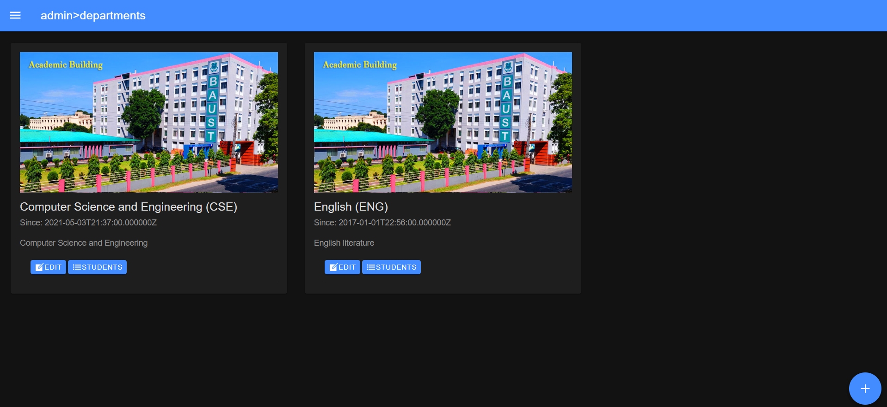
Admin Panel
Department:
Database

Slide 16
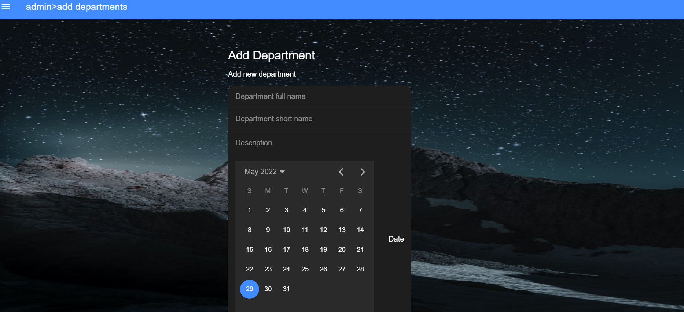
Admin Panel
Create New Department:

Slide 17
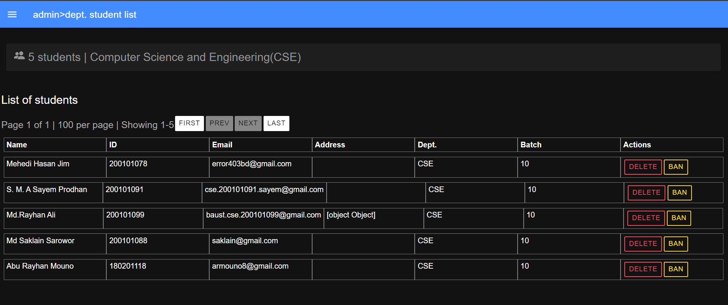
Admin Panel
List Of Students:

Slide 18
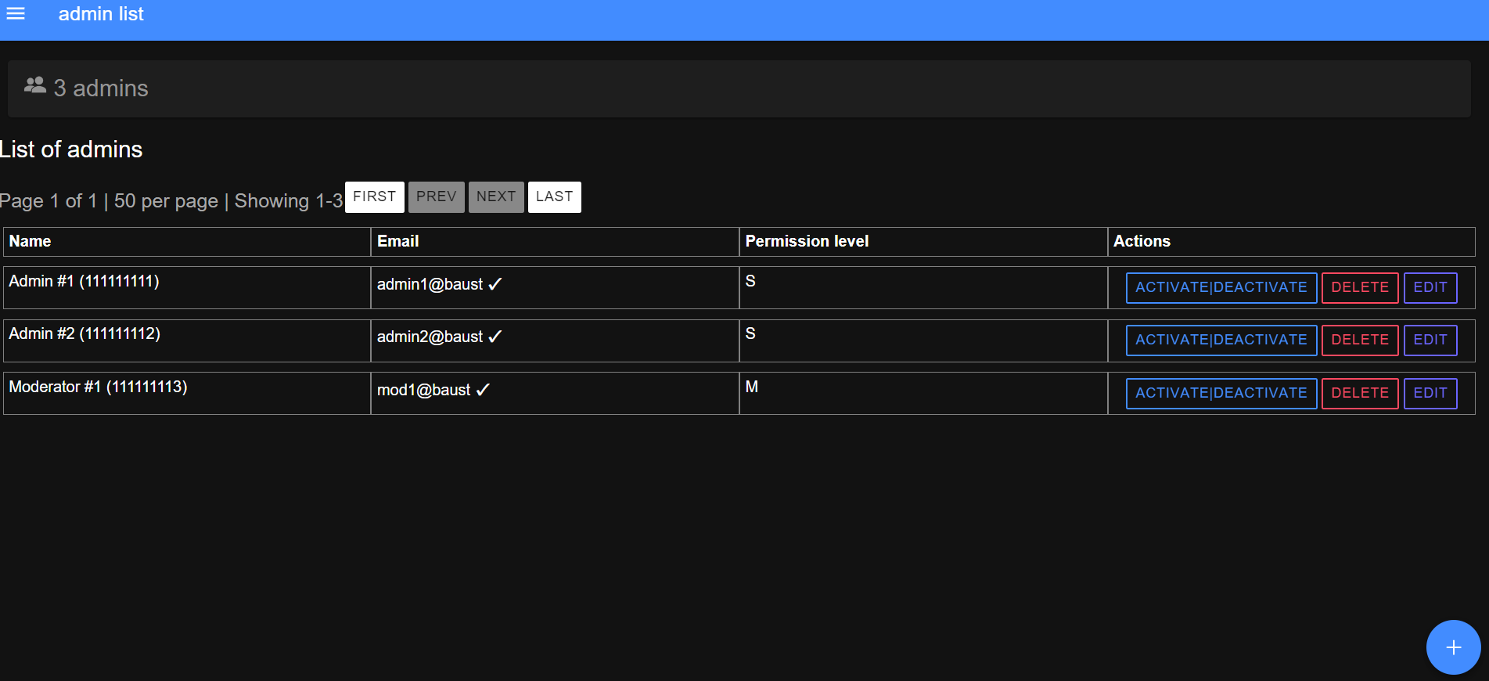
Admin Panel
Admin List:

Slide 19
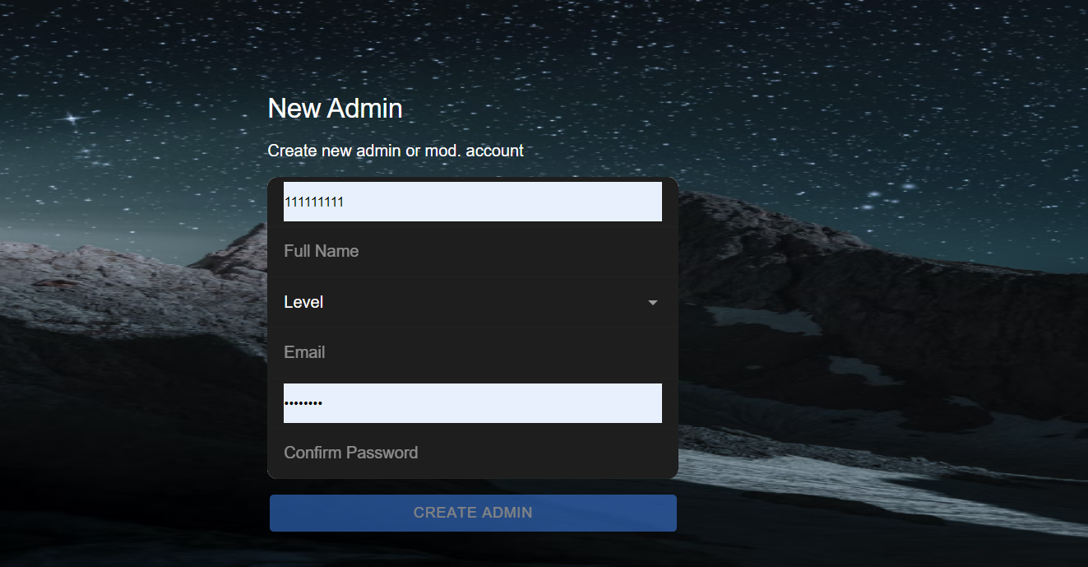
Admin Panel
Create New Admin :

Slide 20
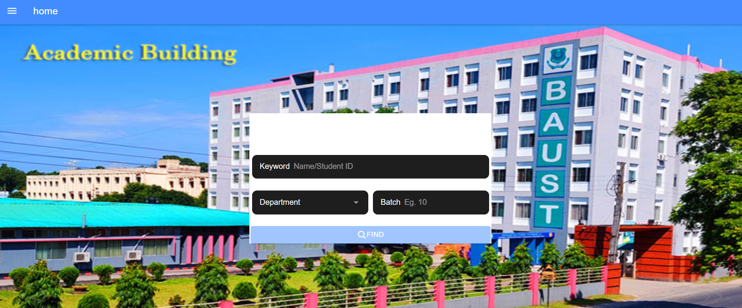
Frontend view for App & Web:
Homepage:

Slide 21
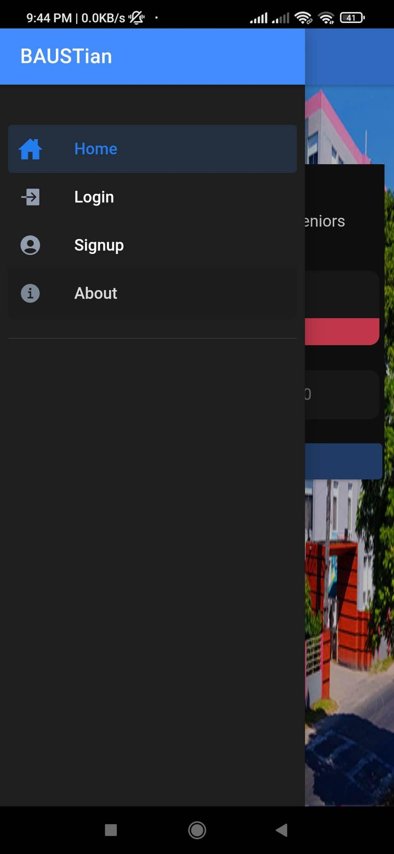
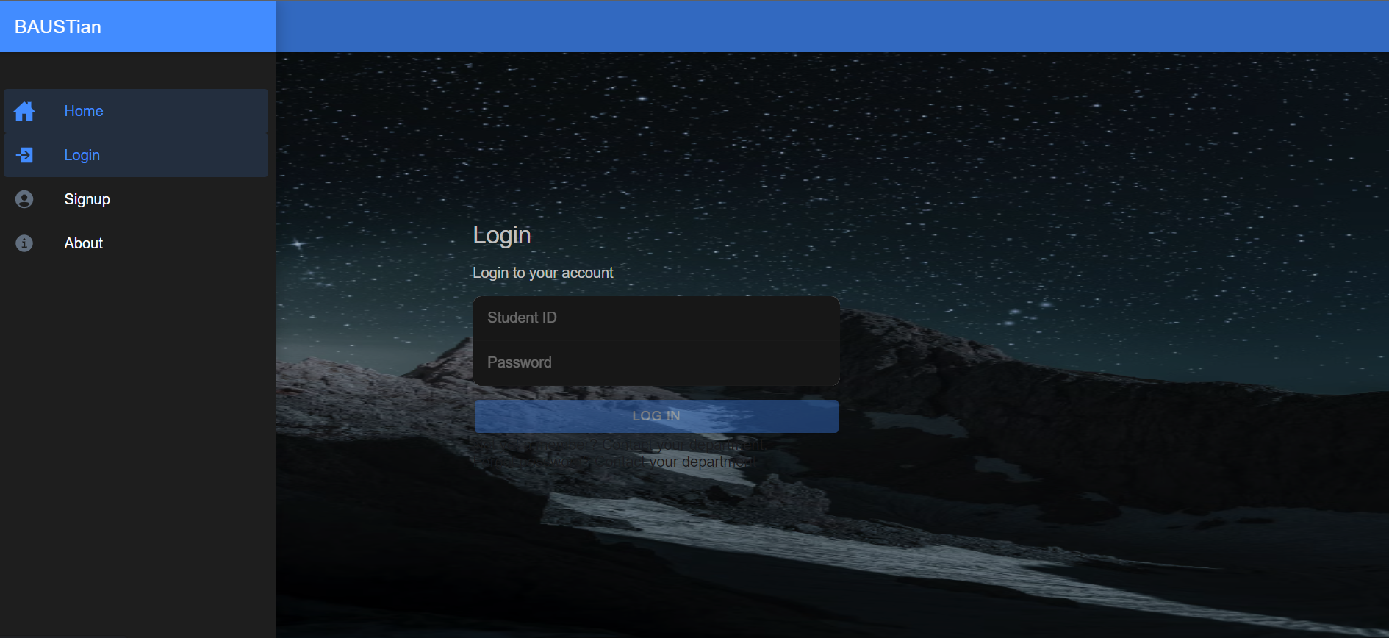
Frontend view for App & Web:
Menubar Without login:

Slide 22
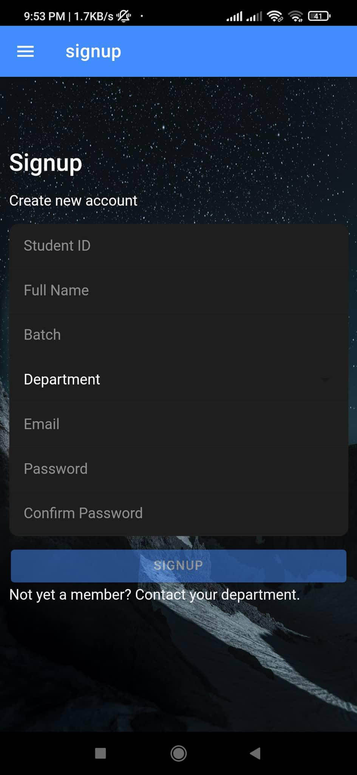
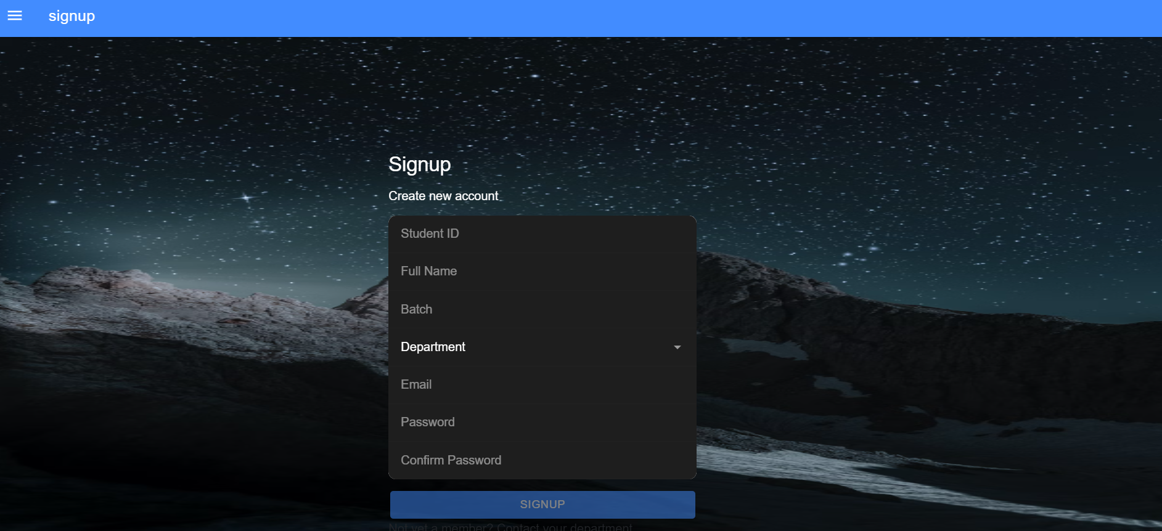
Frontend view for App & Web:
Signup:

Slide 23
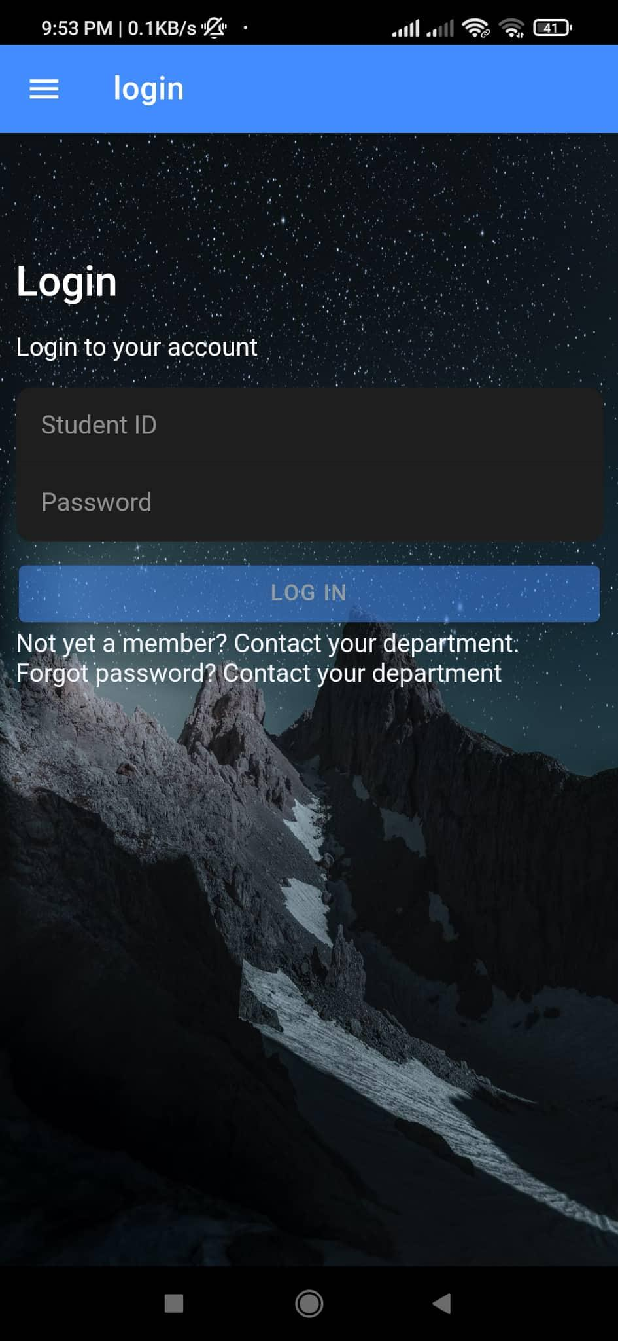
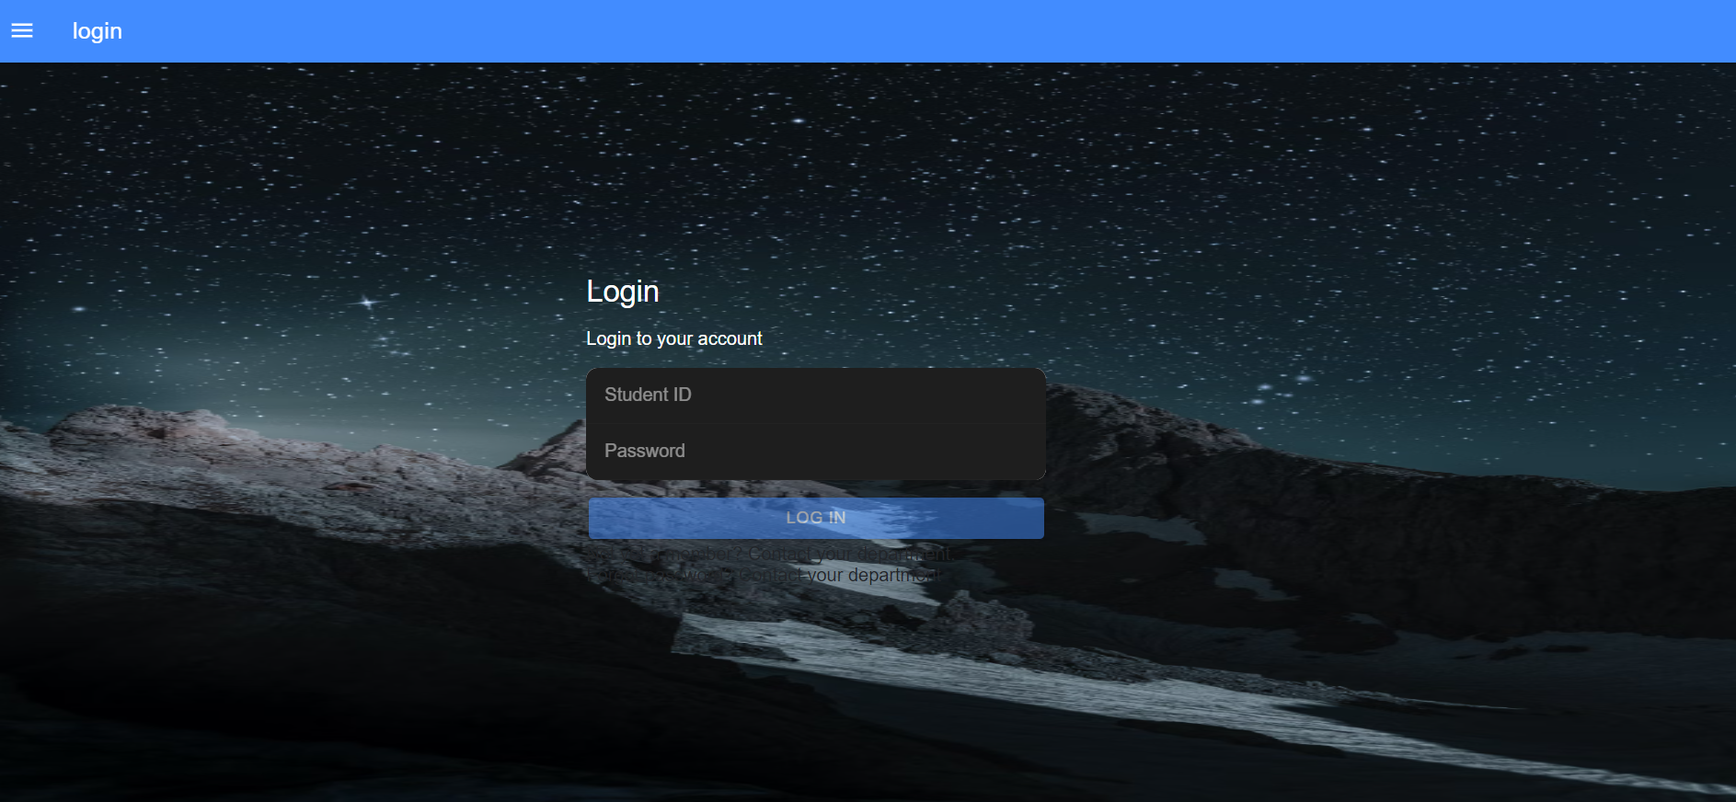
Frontend view for App & Web:
Login:

Slide 24
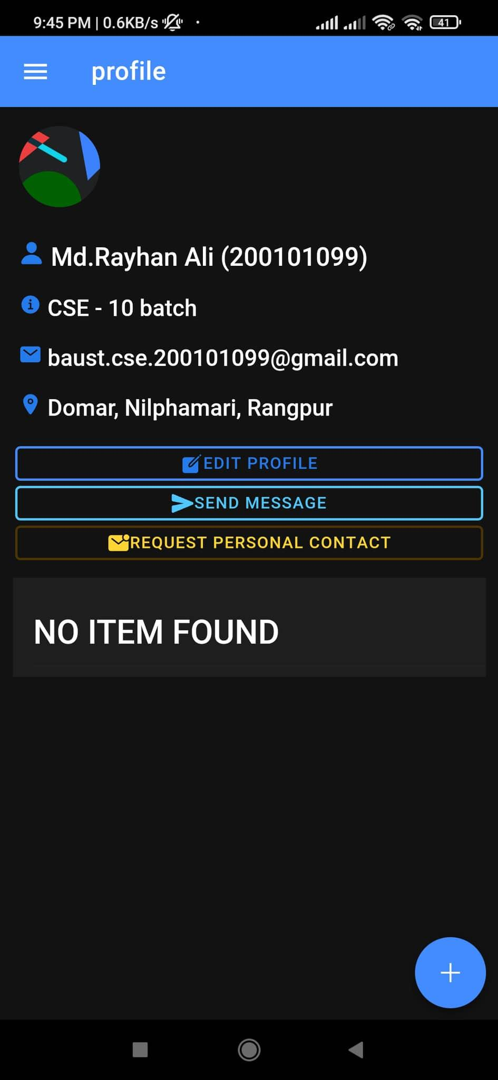
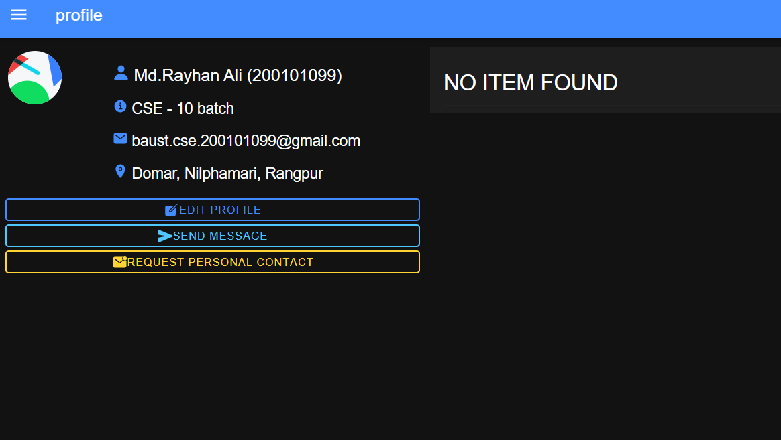
Frontend view for App & Web:
Profile:

Slide 25
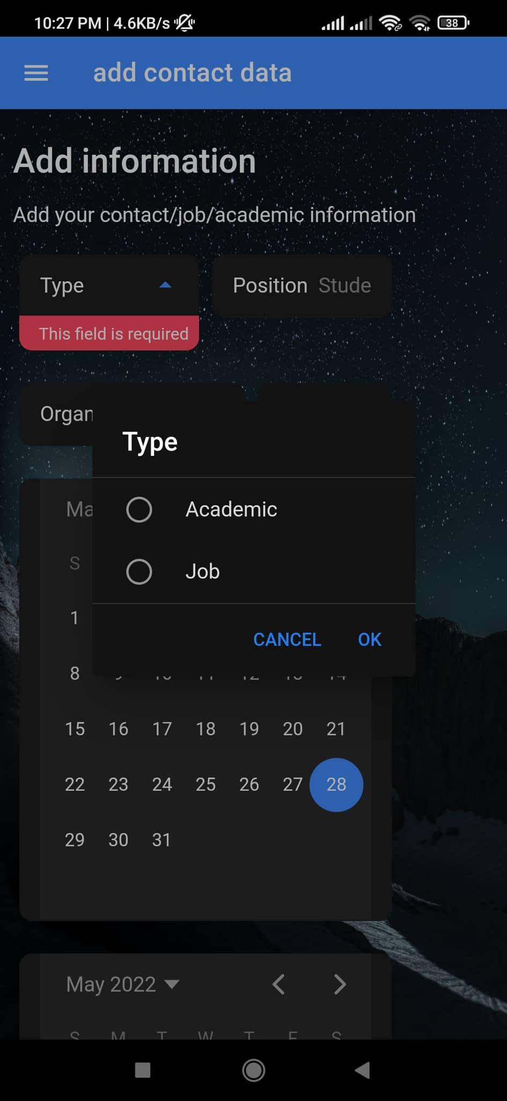
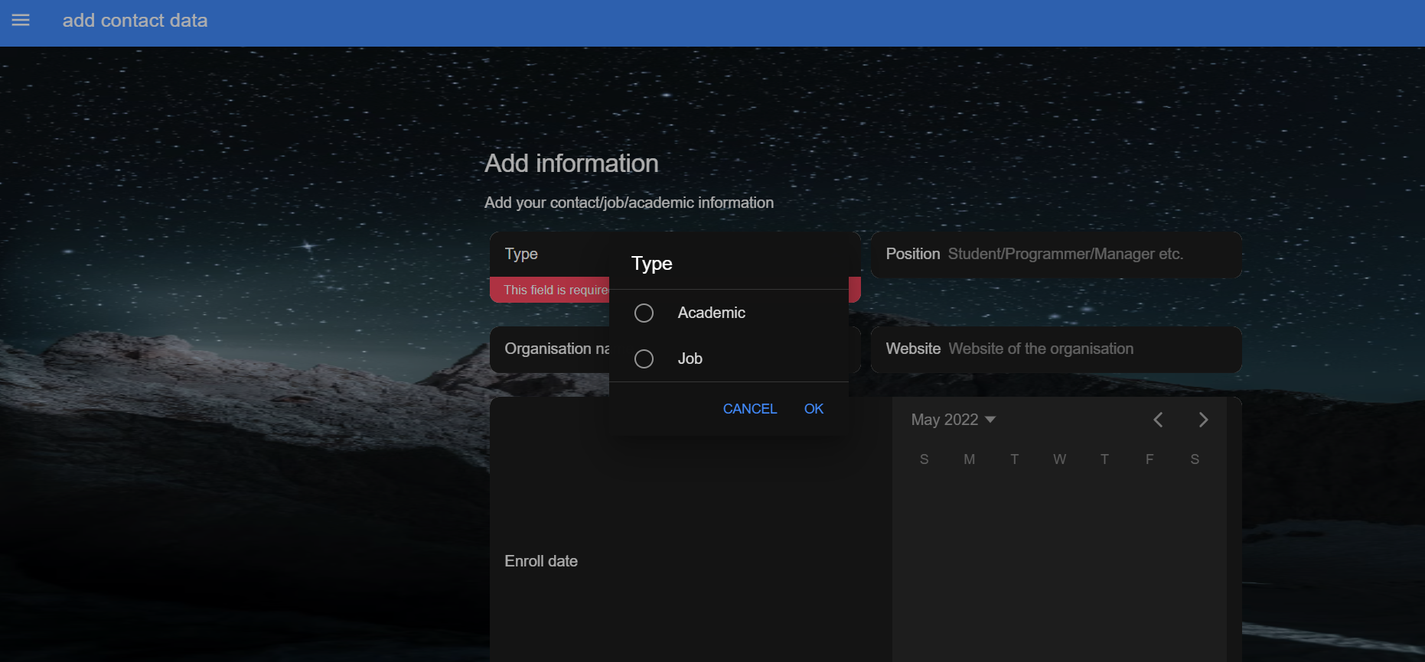
Frontend view for App & Web:
Add information:

Slide 26
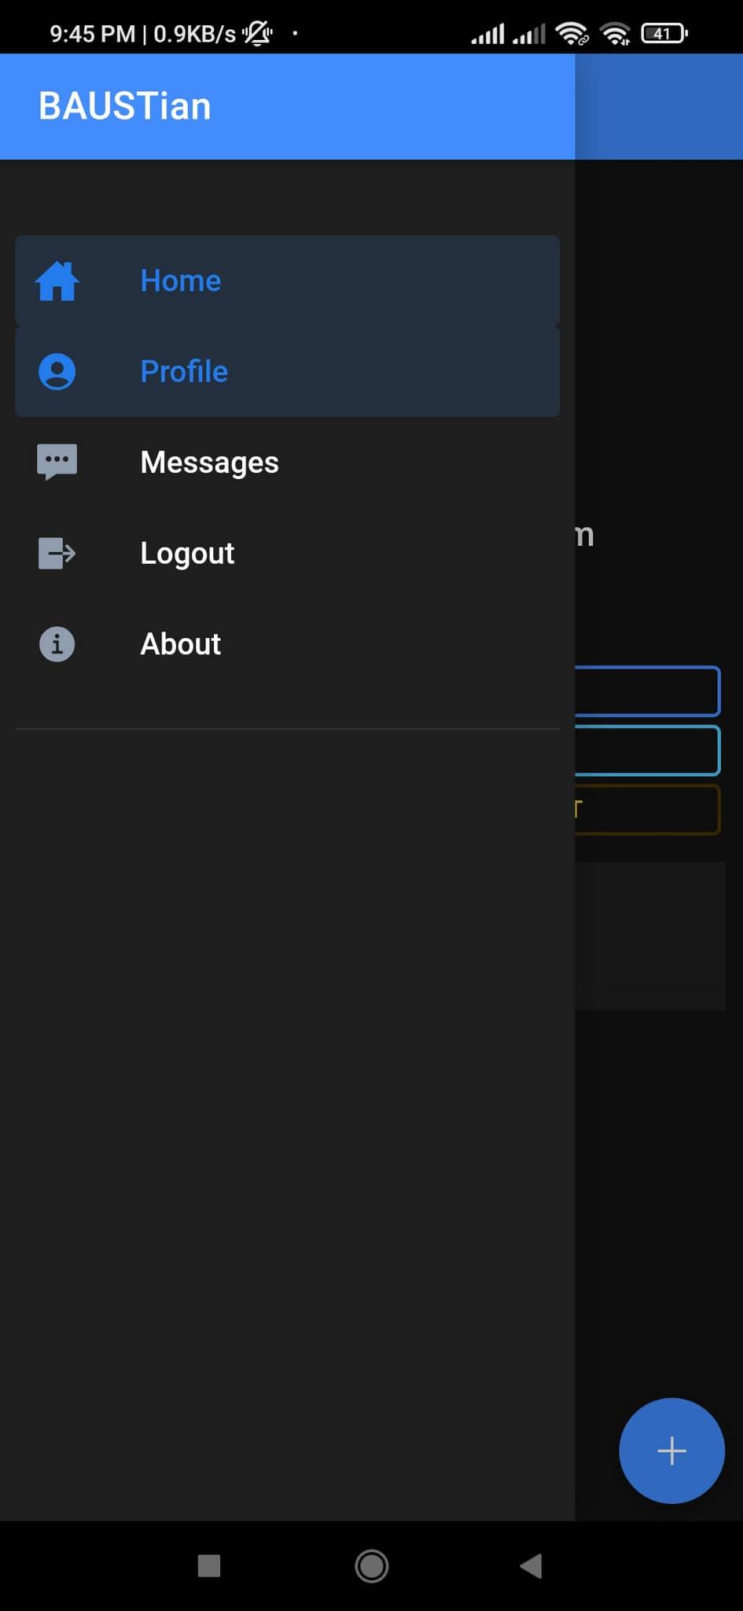
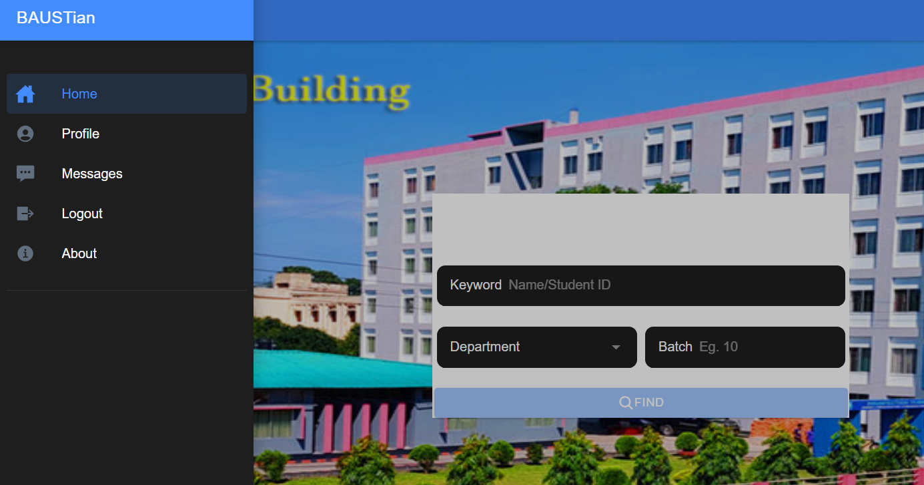
Frontend view for App & Web:
After Login Menuber:

Slide 27
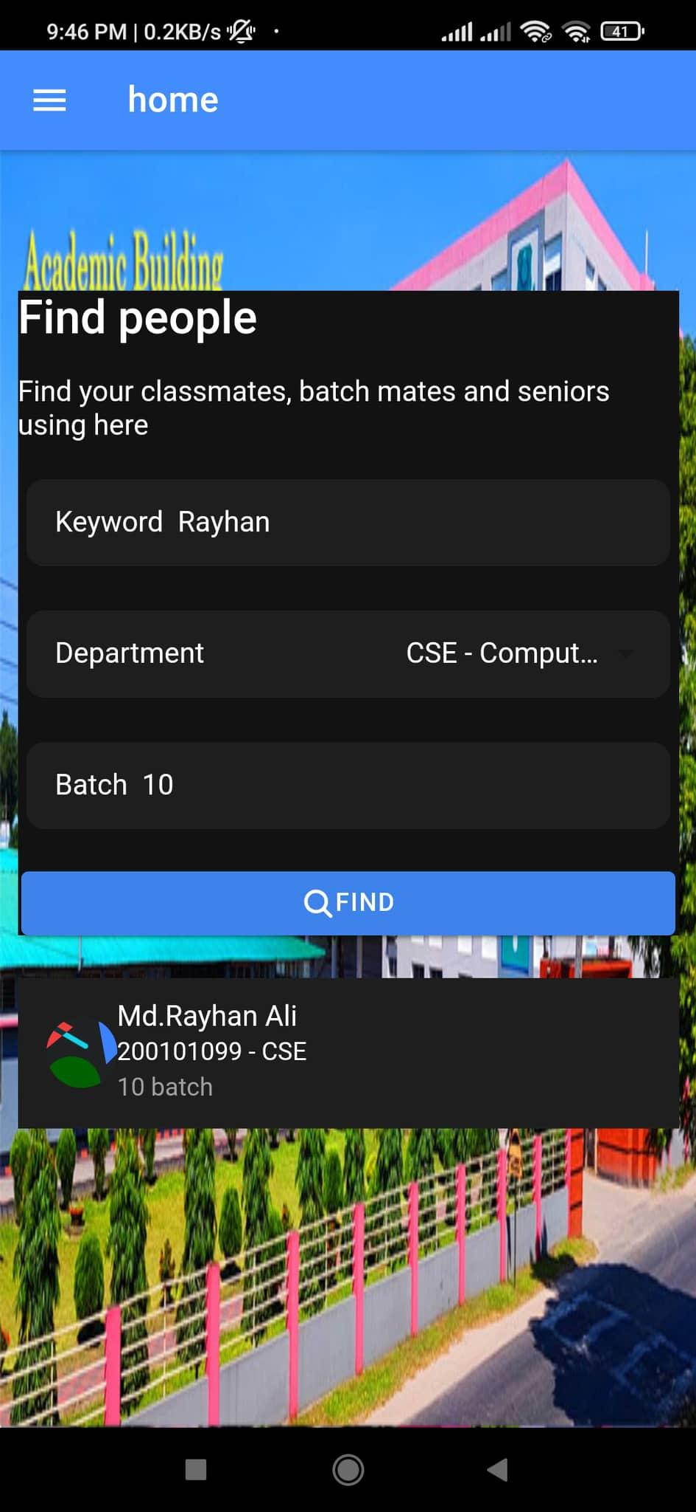
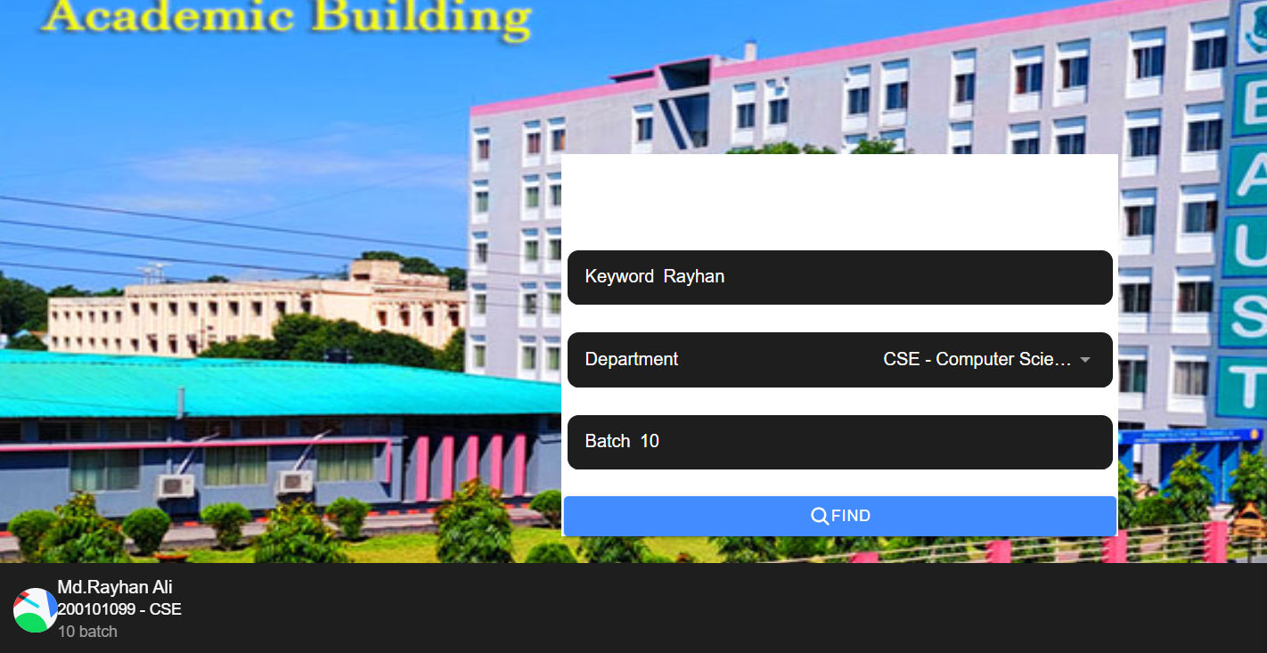
Frontend view for App & Web:
Searchber:

Slide 28
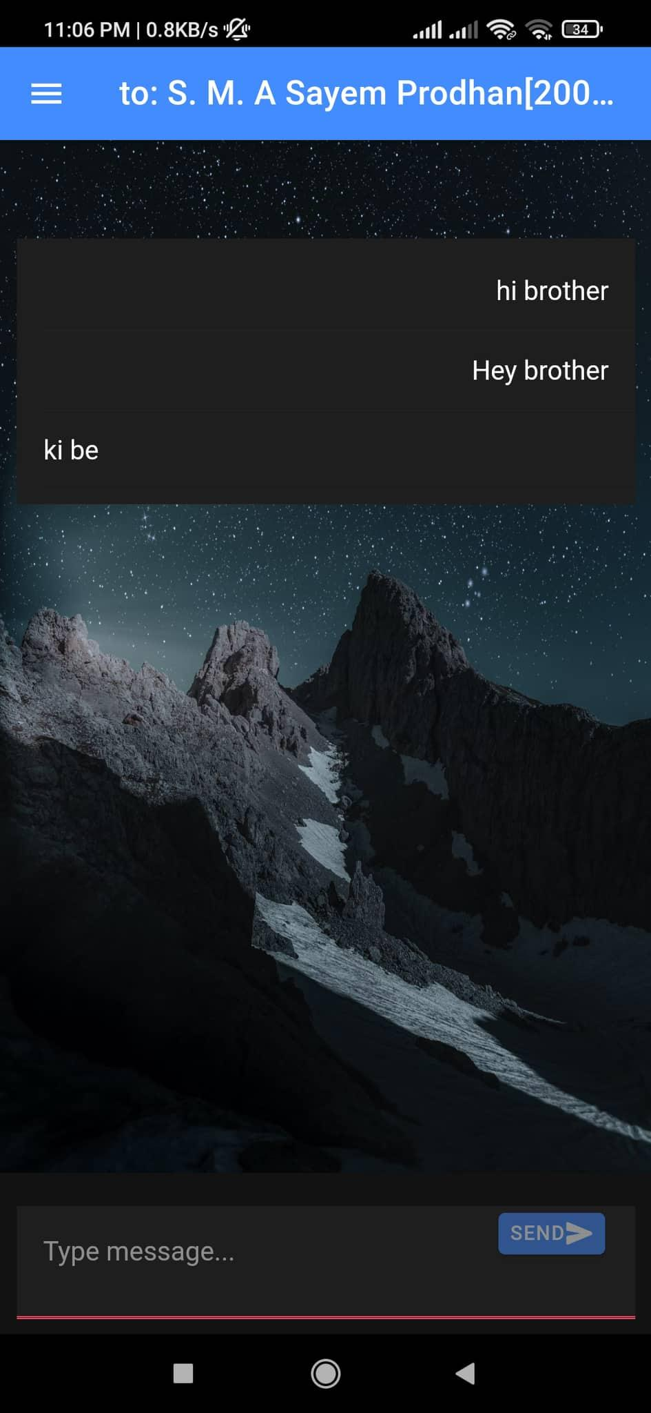
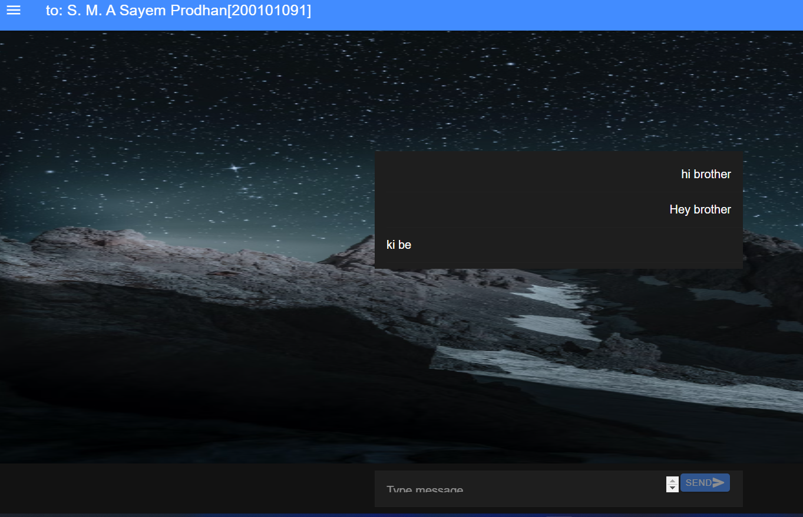
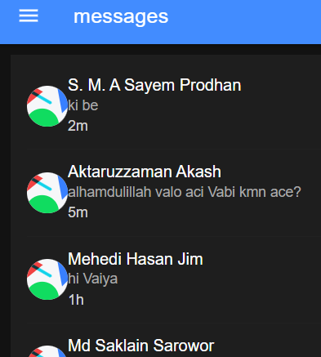
Frontend view for App & Web:
Message:

Slide 29
Conclusion
By the end of the project we will have a platform for BAUST students to connect with each other. With this project we will learn and improve our knowledge on software development in real world.

Slide 30




